Slide 1
CITI Bike Trip Data Analysis
Team: SunnyBike
Shefang Wang
Chenhui Liu
Tongge Huang

Slide 2






Summary
Outline:
Preliminary Analysis
Time Serious Analysis
Spatial Analysis
Modeling Analysis
Safety Analysis
Tools:
Data:

Slide 3
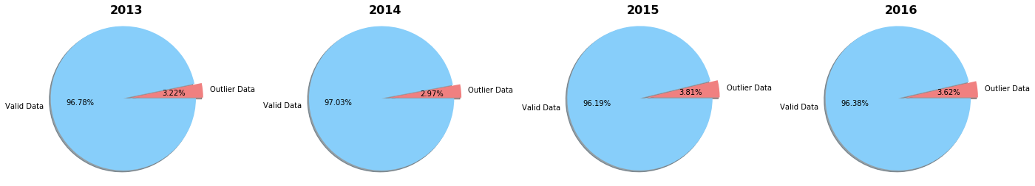
Data Quality
Data from 2013/07 ~ 2016/09
# of rows — 33,319,019
Two type of users
Customer: within 30 mins
Subscribers: within 45 mins
Outliers to remove. ~3%

Slide 4
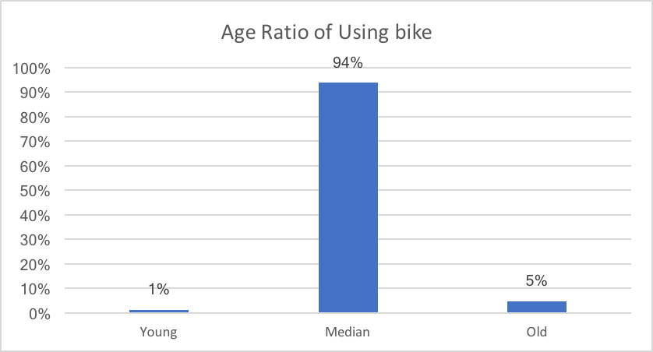
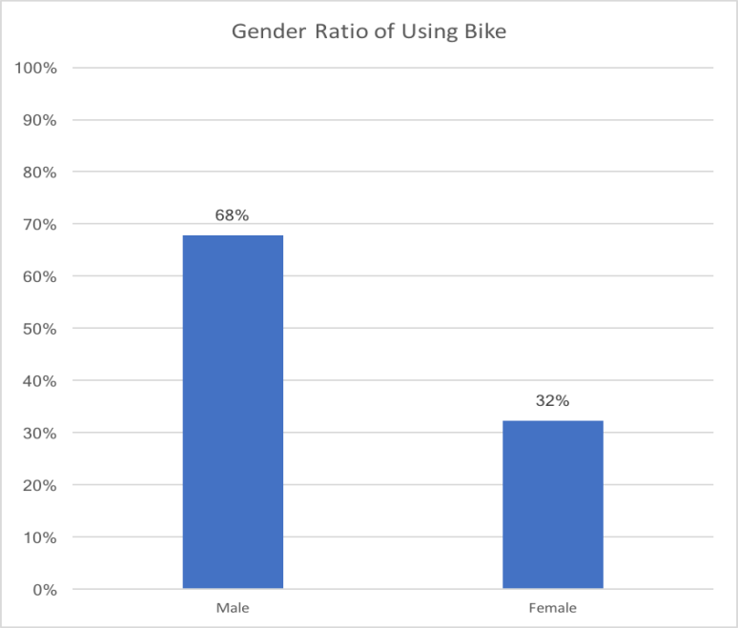
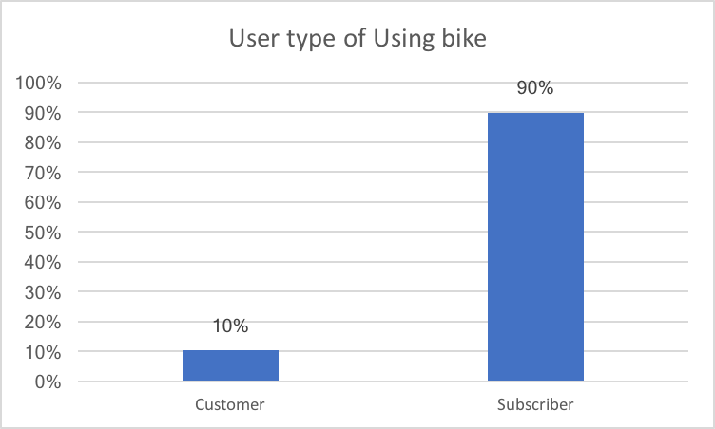
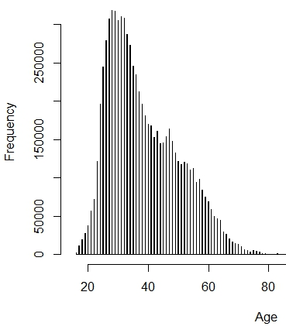
Preliminary Data Analysis

Slide 5
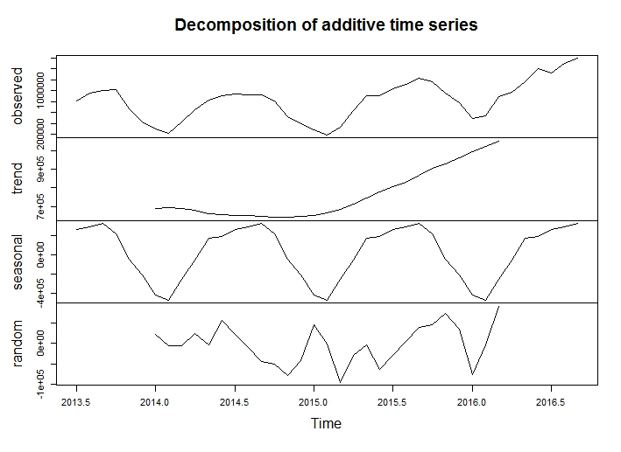
Time Serious Analysis
Observations:
Number of bike trips is increasing
Seasonal pattern
Peaks at Summer
Lows at Winter

Slide 6
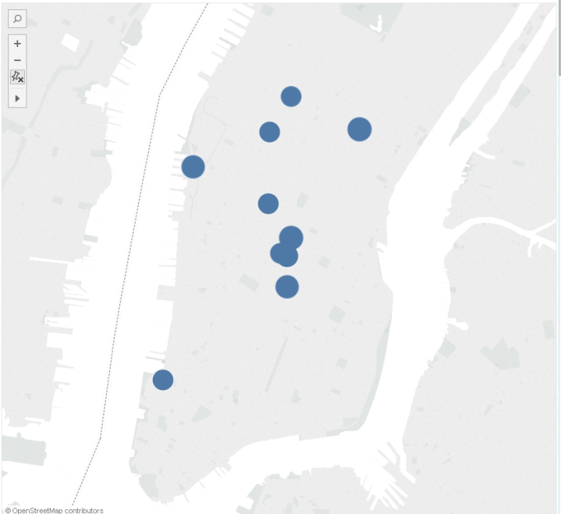
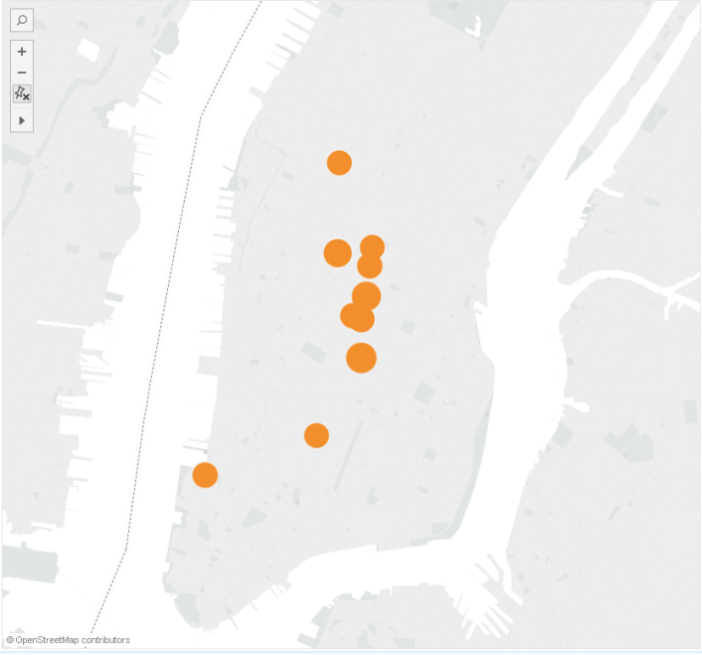
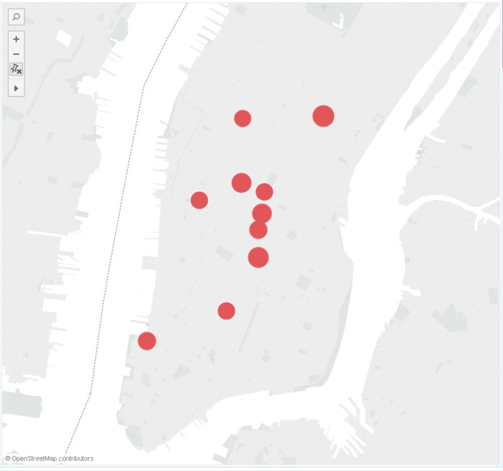
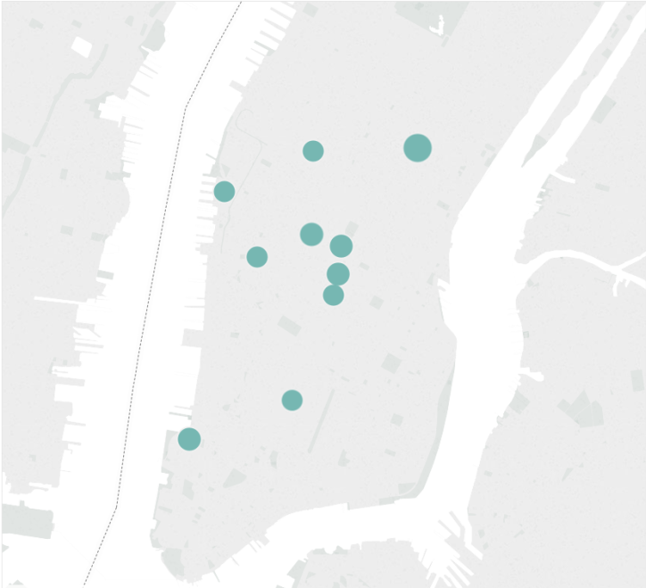
Spatial Analysis — Hot Spots (Top 10) Analysis
2013
2014
2015
2016

Slide 7
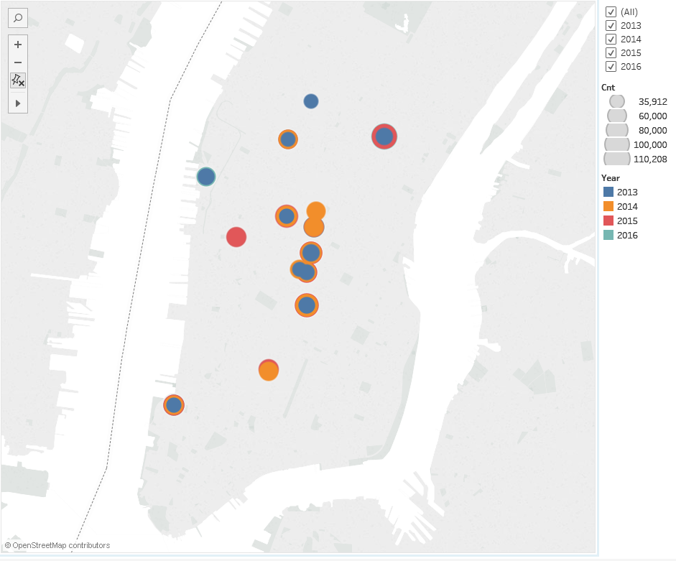
Spatial Analysis — Hot Spots (Top 10) Analysis
Observations:
Hot Spots are located at midtown
Tech companies, SoHo shopping areas, 5th ave, etc.
Wall Street financial districts

Slide 8
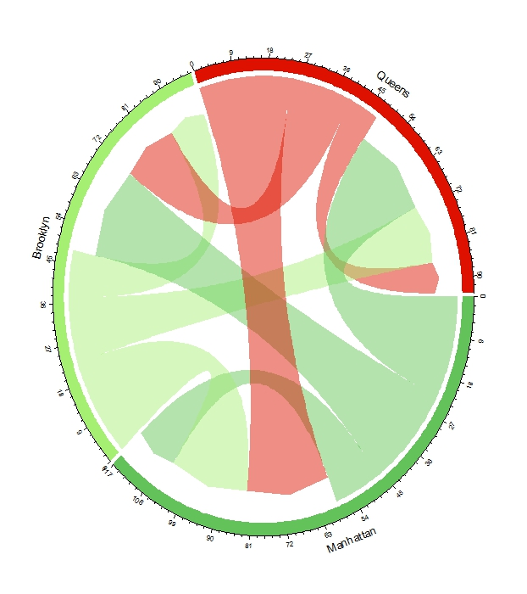
Territory Analysis—Trip Duration
Observations:
Within Borough takes lest time
Queens to/from:
Manhattan > Brooklyn > Queens

Slide 9
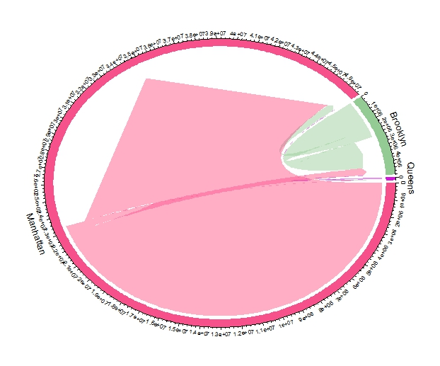
Territory Analysis—Trip Frequency
Observations:
Most of trips were travelled within the borough
# of trips ranking: Manhattan > Brooklyn > Queens

Slide 10
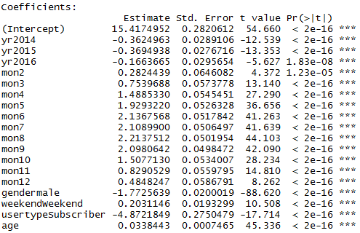
Modeling Analysis
Observations:
Trips duration is decreasing, since the # of bike station is increasing
Male > Female
Weekday > Weekend
Summer > Winter
Subscribed user > Short term Customer user
Older people tend to ride longer

Slide 11
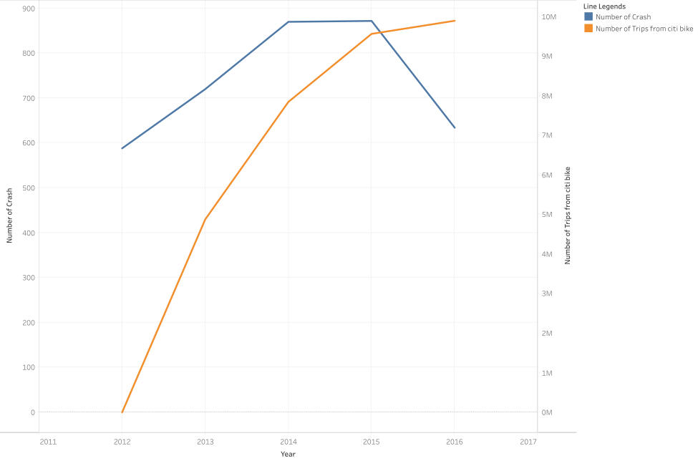
Safety Analysis
Observations:
The # of Trips is increasing, whereas the # of bike accident is decreasing
Therefore, CITI bike implementation does not jeopardized roadway bike safety

Slide 12
Thanks!

